Slide 1
MODULE 2
Konnichiwa, Hajimemashite
Daily greetings and basic phrases to introduce yourself Express about your name, occupation, age, where you live, where you are from and what language you can speak Body Language such as bowing, pointing to your face, etc.

Slide 2
AISATSU (GREETINGS )
Good Morning – Ohayou Gozaimasu
Good Afternoon/Hello – Konnichiwa
Good Evening –Konbanwa(kombawa)
Good Night – Oyasumi Nasai
Excuse me – Sumimasen
Sorry – Gomen Nasai
Thank you – Arigatou Gozaimasu

Slide 3
AISATSU (GREETINGS )
See you – Jaa mata
Tomorrow – Ashita
Yesterday – Kinou
Today – kyou
Student – Gakusei
Yes – Hai
No – Iie
Teacher - Sensei

Slide 4
KAZU (NUMBERS )
Ichi -1
Ni -2
San - 3
Yon/shi -4
Go- 5
Roku -6
Shichi/Nana - 7
Hachi -8
Kyuu-9
Jyuu -10
Zero/Rei - 0

Slide 5
KAZU (NUMBERS )
11 – 10+1 – Jyuu ichi
21 -2*10+1 – Nijyuu ichi
100 – Hyaku
1000 – Sen
10000 – Man
Examples to try
77
54
36
48

Slide 6
Week days (Youbi)
Sunday – Nichiyoubi
Monday – Getsuyoubi
Tuesday – Kayoubi
Wednesday – Suiyoubi
Thursday – Mokuyoubi
Friday – Kin’youbi
Saturday – Doyoubi

Slide 7
Month(Gatsu)
January – Ichi gatsu
February – Ni gatsu
March – San gatsu
April – Shi gatsu
May – Go gatsu
June – Roku gatsu

Slide 8
Month(Gatsu)
July – Shichi gatsu
August – Hachi gatsu
September – Ku gatsu
October– Jyuu gatsu
November –Jyuu ichi gatsu
December –Jyuu ni gatsu

Slide 9
COLOURS(IRO)
  Aka – Red
  Ao – Blue
  Shiro – White
  Kuro – Black
  Midori – Green
  O genki desuka – How are you
  Genki – Healthy
  Hai .Genki desu – Yes. I am fine

Slide 10
Conversations (kaiwa)
O namae wa nan desuka – What is your Name
Name – Namae
Nani – What
I am _____________
Watashiwa ____________ desu
Watashiwa – I
Desu- am/is/was

Slide 11
JIKOSHOKAI
(Self Introduction)
Hajimemashite – How do you do
Watashiwa _____________ desu - Iam _______
Tambaram kara kimashita – coming from
Yoroshiku Onegaishimasu - Nice to meet you /Glad to met you

Slide 12
JIKOSHOKAI- Part 2
(Self Introduction)
Vocabulary :-
Sai – Age
Sunde imasu – Live
Jin – Nationality
Go - language
Eigo – English
Nihongo – Japanese
Dekimasu – Can /can speak
Dekimasen – Cant speak
Indojin – Indian
Gakusei – Student
Doitsugo – German Language
Furansugo – French language

Slide 13
JIKOSHOKAI- Part 2
(Self Introduction)
Hajimemashite – How do you do
Watashiwa _____________ desu - Iam _______
Chennai ni sunde imasu - Living in Chennai
Hatachi desu - Iam 20 years old
Watashiwa VIT no gakusei desu – Iam a student
Tambaram kara kimashita – coming from Tambaram
Watashiwa Indojin desu – Iam an Indian
Eigo to Nihongo ga dekimasu – I can speak English and Japanese
Yoroshiku Onegaishimasu - Nice to meet you /Glad to met you

Slide 14
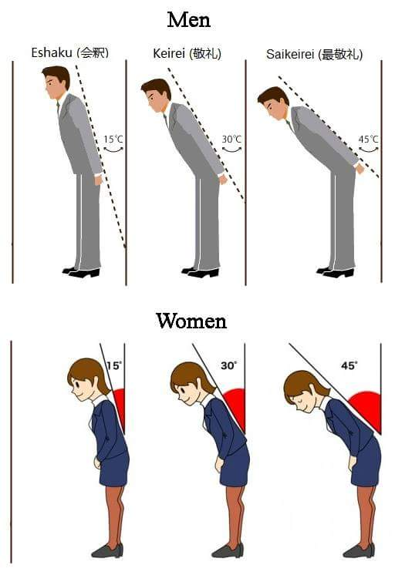
Ojigi – Bowing system

